Slide 1

Low Level O3 Concentration Study
5011CEM – Big data programming project

Slide 2

Create visual tools that allow to easily formulate a visual study of the concentration of low level O3 in Europe. Show how different models might differ on the same positions of the map.
introduction

Slide 3
The data

Slide 4
The first aim was the one seen before, plotting the data from each model. The second aim would need to be a actual extraction of a small set of data points and compare them.
Division of work

Slide 5
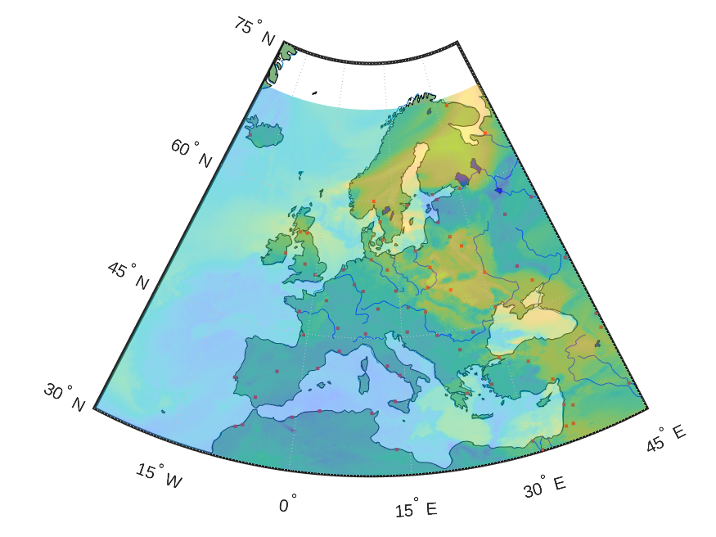
Plotting the data
Latitude, Longitude and Time.
Need for a 2D array instead of the original 3D.
Create the Europe map (land, coast, water, cities).
Understand the colour code of the data.
EMEP Model Hourly Mean Plot

Slide 6
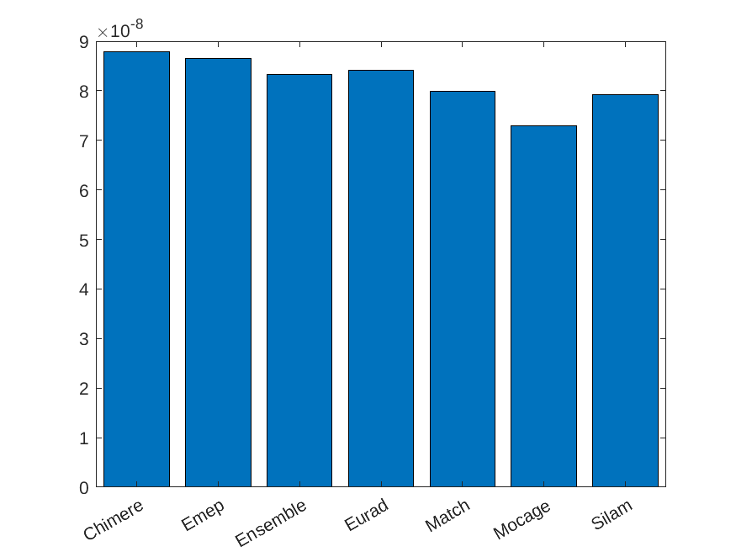
Compare the models
Need for an accurate point (Portugal).
To ensure better accuracy took 3 geographic points.
Do not make any assumptions.
Bar chart is enough.

Slide 7
What could be improved?
Future work

Slide 8
Accessibility
Main issue of this project!
Allow the work to be seen by everyone, or used by those who can’t see.
Blindness / Colour Blindness / Eye dystrofies / etc.

Slide 9
Stable connection with client
Allow for future work is allowing for present work.
Maintaining a close connection with the client to attend to their needs.
Adaptability of the project need for improvement.

Slide 10
In what way would you need to adapt your code if we had to process 10 years of data? State 3 ways in which you adapted either your project outline, specification and flow chart (or other code planning method) as your project progressed. If you made no changes, please say so. Our next project will analyse atmospheric CO2 over Europe. If the data is provided in the same format describe how easy will it be to adapt your code to work with this new data?
Questions

